Slide 1


Slide 2



What you will learn
Explain the value of props and default props in components
Summarize how to use props to pass data between components
Discuss how events work in conjunction with props

Slide 3



Introduction to props
Data flow
Props store data
Pass attributes

Slide 4

Read only data
Immutable
A child cannot change attributes

Slide 5


Default value purpose
Consistent rendering
Prop data not supplied in the parent

Slide 6
Principles
Reusability
Customization
Unidirectional data flow
Composition

Slide 7
Principles explained
Reusability
Minimize code duplication
Customization
Simple yet robust
Unidirectional data flow
Code readability
Testing and debugging
Composition
Keeps code simple
Build complex UIs

Slide 8
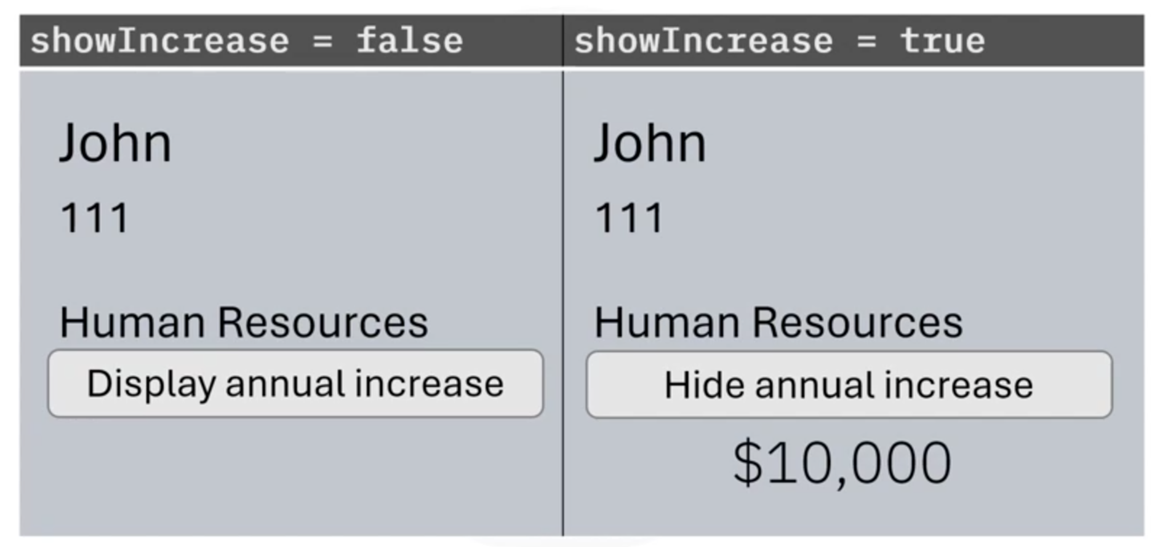
Output

Slide 9
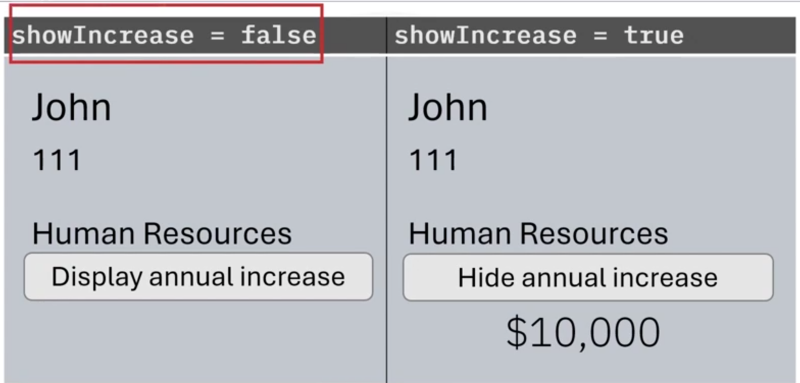

Slide 10
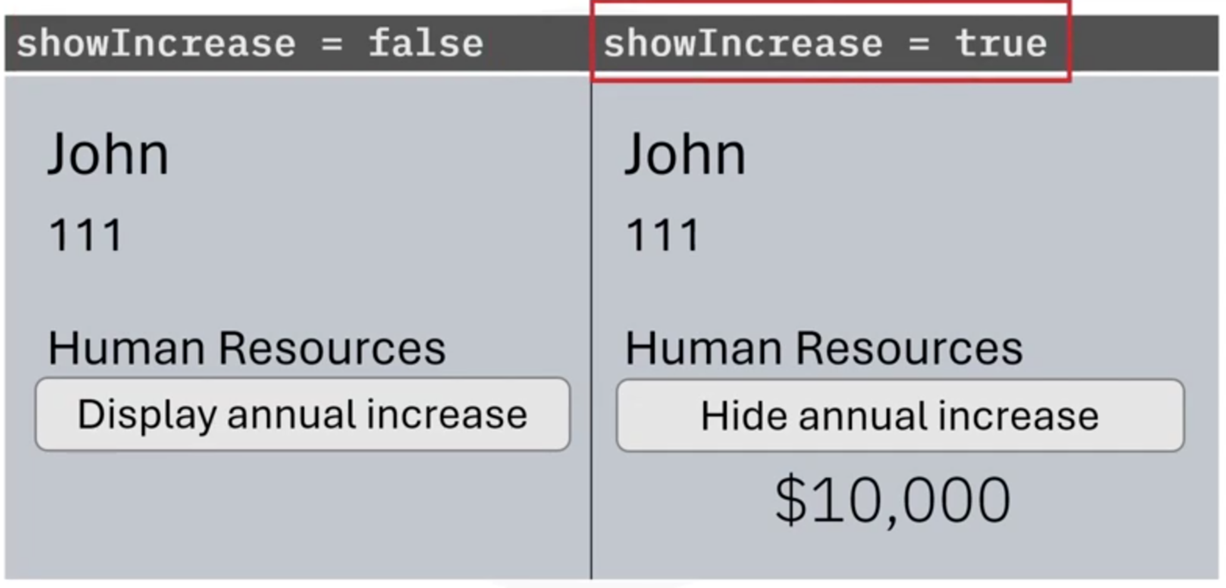

Slide 11
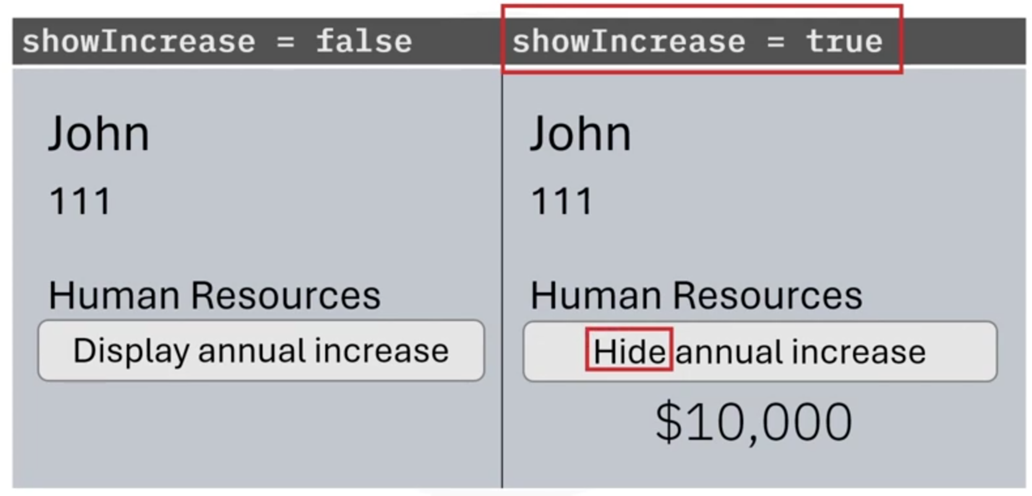

Slide 12
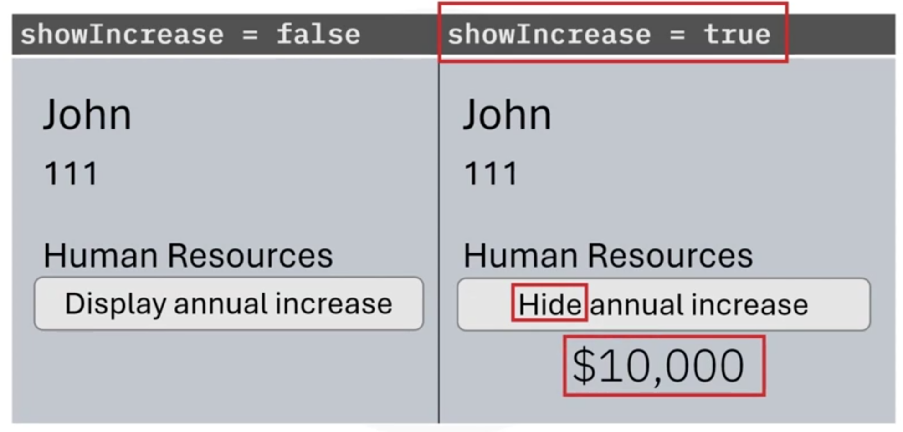

Slide 13
Recap
In this video, you learned that:
A prop stores the attributes of a component and allows you to pass these attributes from parent to child
You pass a props object as a parameter into a component. Define the data using the dot operator in the format ‘props. attributeName’
Props principles include reusability, unidirectional data flow, customization, and composition
You can use the ‘useState’ hook in conjunction with an event to control the UI in a child component

